Slide 1
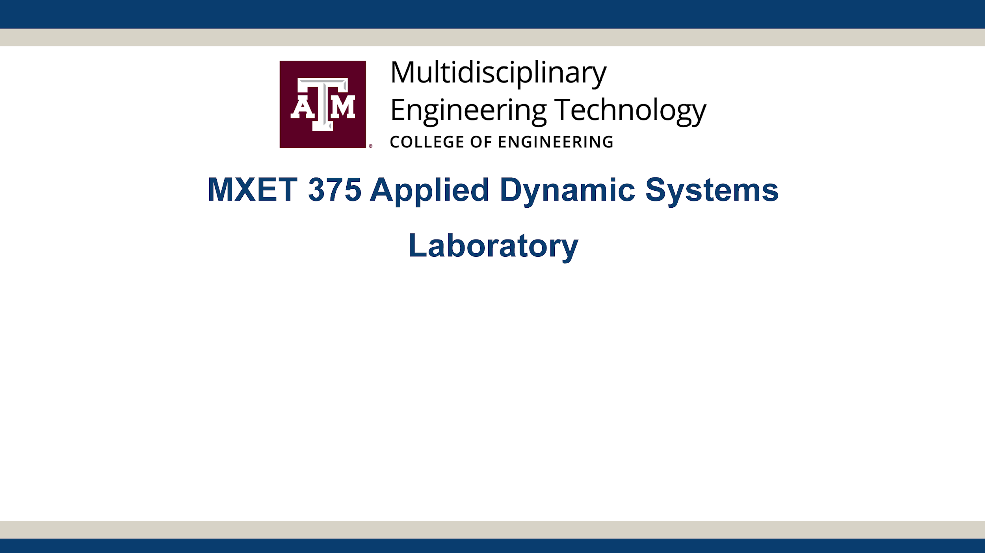
Ball and Beam
Section 906 - Group 27
Kyle Rex, Vedansh Shah, Matthew Trevino

Slide 2
Proposal Links
YouTube Video Link:
https://youtu.be/LGkVe7szx5k
Team Folder Link:
https://drive.google.com/drive/folders/1XYHI5zW7jzhonW9jSEi2PNOZHzeOfwnl?usp=drive_link

Slide 3
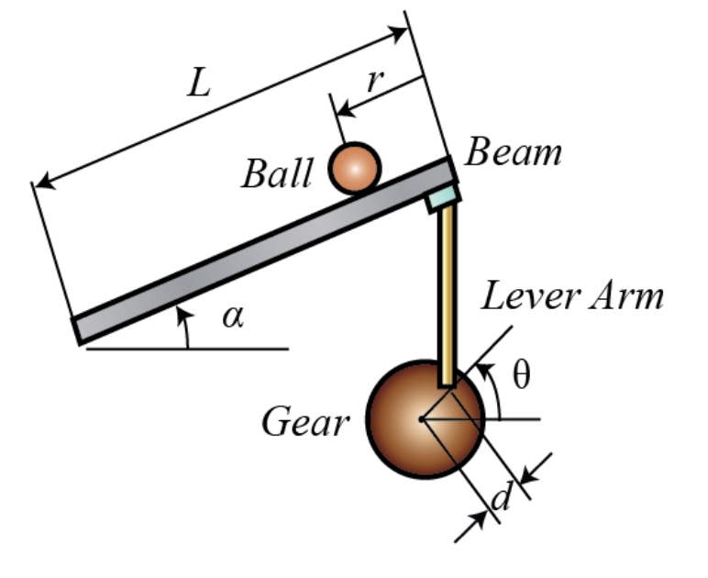
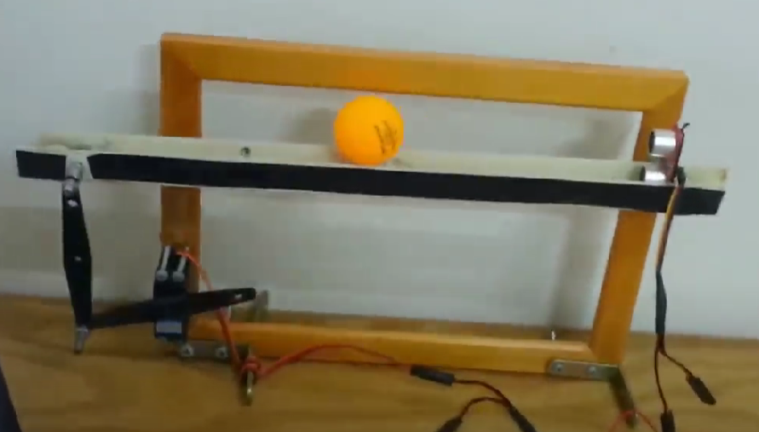
Project Description
A ball is placed on a beam, which can tilt and allows the ball to roll along its length, giving the ball one degree of freedom.
One end of the beam is connected to a lever arm which is connected to another lever arm attached to a servo motor, while the other end of the beam is fixed.
The servo gear rotates by an angle θ, which adjusts the lever arms and causes the beam to tilt by an angle α.
Tilting the beam creates a slope that makes the ball roll due to gravity, depending on the tilt angle.
The goal is to design a controller for this system to control the position of the ball along the beam by adjusting θ.
Project Concept

Slide 4
Plan Of Execution
Mechanical
Build ramp, backboard, and motor arms
Setup motor and sensors
Setup Arduino Uno connections
Electrical & Computer
Create Arduino code to control motor to balance ball
Configure sensor to work
Debug, connect, and complete system
Simulation
Create an initial Simulink simulation to make sure modeling it is feasible
Create final Simulink simulation modeling the complete system
Create an output that shows the change in distance of the ball throughout the simulation

Slide 5
Distribution of Work
Name | Assignments
Kyle Rex | 1. Purchase all materials required for prototype: Motor, Arduino, Sensor, 5V Converter, Joints, and Cardboard.
 | 2. Create the physical initial prototype to be ready for testing: Build ramp, backboard, and motor arms. Setup motor and sensors. Setup Arduino Uno connections.
 | 3. Create MATLAB code to model the distance of the ball throughout the physical demonstration to compare with the output of the Simulink simulation.
Vadansh Shah | 1. Create Arduino code for prototype: Create Arduino code to control motor to balance ball.
 | 2. Configure all parts appropriately to test and make the initial prototype work: Debug, connect, and complete system.
 | 3. Improve initial prototype into a final prototype by improving design where required.
Matthew Trevino | 1. Create an initial Simulink simulation to make sure modeling it is feasible.
 | 2. Create final Simulink simulation modeling the complete system.
 | 3. Create an output that shows the change in distance of the ball throughout the simulation trying to get it to match as closely as possible to the physical demonstration result.

Slide 6
Timeline
Task # | TASK TITLE | TASK OWNER | START DATE | DUE DATE | Week 1 |  |  |  |  | WEEK 2 |  |  |  |  |  |  | WEEK 3
 |  |  |  |  | T | W | R | F | S | S | M | T | W | R | F | S | S | M | T | W | R | F | S
1 | Simulation |  |  |  | 5 | 6 | 7 | 8 | 9 | 10 | 11 | 12 | 13 | 14 | 15 | 16 | 17 | 18 | 19 | 20 | 21 | 22 | 23
1.1 | Create an initial Simulink simulation | Matthew Trevino | 11/5 | 11/11 | x | x | x | x | x | x | x
1.2 | Improve the Simulink simulation | Matthew Trevino | 11/11 | 11/15 |  |  |  |  |  |  | x | x | x | x | x
1.3 | Complete the Simulink simulation completely | Matthew Trevino | 11/11 | 11/17 |  |  |  |  |  |  | x | x | x | x | x | x | x
2 | Physical Model Design and Assembly
2.1 | Purchase materials required for the physical model | Kyle Rex | 11/5 | 11/13 | x | x | x | x | x | x | x | x | x
2.2 | Assemble the physical model | Kyle Rex | 11/10 | 11/15 |  |  |  |  |  | x | x | x | x | x | x
2.3 | Create MATLAB code to record the position of the ball over time | Kyle Rex | 11/10 | 11/15 |  |  |  |  |  | x | x | x | x | x | x
3 | Data collection and demonstration
3.1 | Create the code that controls the motor based on a measured position | Vadansh Shah | 11/5 | 11/15 | x | x | x | x | x | x | x | x | x | x | x
3.2 | Collect data from both the Simulink simulation and the physical model | Vadansh Shah | 11/15 | 11/17 |  |  |  |  |  |  |  |  |  |  | x | x | x
3.3 | Demonstrate project to the professor and Teacher assistant | Kyle, Matthew, Vadansh | 11/22 | 11/22 |  |  |  |  |  |  |  |  |  |  |  |  |  |  |  |  |  | x

Slide 7
Expected Outcomes
Working prototype that balances ball
The prototype can balance the ball in the center of the beam in less than 20 seconds
Complete a working simulation that models the movement of the ball
The simulation should have less than 25% error from the physical prototype
Better understand how to model feedback control in mechanical systems
Learn how to integrate coding and Simulink simulations to model a desired system
Identify sources of error between the simulation and the physical prototype

